Slide 1
A Technique for Architecture Design
Mahesh Shirole
Microsoft Application Architecture Guide

Slide 2
Agenda
To learn an iterative technique to build an architecture
Overview
Design Steps
Step1: Identify Architecture Objectives
Step2: Key Scenarios
Step3: Application Overview
Step4: Key Issues
Step5: Candidate Solutions

Slide 3
Overview
The inputs to your design can help you to formalize the requirements and constraints that your architecture must accommodate
use cases and usage scenarios, functional requirements, non-functional requirements (including quality attributes such as performance, security, reliability, and others), technological requirements, the target deployment environment, and other constraints
During the design process, you will create a list of the architecturally significant use cases, the architecture issues that require special attention, and the candidate architecture solutions that satisfy the requirements and constraints defined in the design process

Slide 4
Overview
Do not try to build your architecture in a single iteration
Architectural process is an iterative and incremental approach
The first candidate architecture will be a high-level design that you can test against key scenarios, requirements, known constraints, quality attributes, and the architecture frame
Each iteration should add more detail
Do not get lost in the details, but instead focus on the major steps and build a framework on which you can base your architecture and design

Slide 5
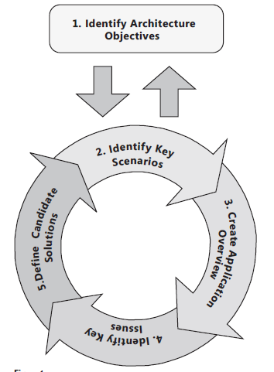
Iterative Technique
An iterative technique consisting of the five major stages shown in Figure
Step1: Identify Architecture Objectives
Step2: Key Scenarios
Step3: Application Overview
Step4: Key Issues
Step5: Candidate Solutions

Slide 6
Identify Architecture Objectives
Architecture objectives are the goals and constraints that shape your architecture and design process, scope the exercise, and help you determine when you are finished
Consider the following key points as you identify your architecture objectives:
Identify your architecture goals at the start
The amount of time you spend in each phase of architecture and design will depend on these goals. For example, are you building a prototype, testing potential paths, or embarking on a long-running architectural process for a new application?
Identify who will consume your architecture
Determine if your design will be used by other architects, or made available to developers and testers, operations staff, and management
Identify your constraints
Understand your technology options and constraints, usage constraints, and deployment constraints. Understand your constraints at the start so that you do not waste time or encounter surprises later in your application development process

Slide 7
Identify Architecture Objectives
Based on the high-level goals for your architecture, you can scope the amount of time to spend on each of your design activities
Define clearly the purpose and priorities of your architecture
Creating a complete application design.
Building a prototype.
Identifying key technical risks.
Testing potential options.
Building shared models to gain an understanding of the system

Slide 8
Key Scenarios
In the context of architecture and design, a use case is a description of a set of interactions between the system and one or more actors
A scenario is a broader and more encompassing description of a user’s interaction with the system, rather than a path through a use case
The key scenarios are those that are considered the most important scenarios for the success of your application
It represents an issue—a significant unknown area or an area of significant risk
It refers to an architecturally significant use case
It represents the intersection of quality attributes with functionality
It represents a trade-off between quality attributes

Slide 9
Architecturally Significant Use Cases
Architecturally significant use cases have an impact on many aspects of your design
These use cases are especially important in shaping the success of your application
They are important for the acceptance of the deployed application
Architecturally significant use cases are
Business Critical- The use case has a high usage level or is particularly important to users or other stakeholders when compared to other features, or it implies high risk
High Impact- The use case intersects with both functionality and quality attributes, or represents a crosscutting concern that has an end-to-end impact across the layer and tiers of your application. An example might be a Create, Read, Update, Delete (CRUD) operation that is security-sensitive

Slide 10
Architecturally Significant Use Cases
A good use case will intersect the user view, the system view, and the business view of the architecture
Early in the project, reduce risk by creating a candidate architecture that supports architecturally significant end-to-end scenarios that exercise all layers of the architecture
Using your architecture model as a guide, make changes to your architecture, design, and code to meet your scenarios, functional requirements, technological requirements, quality attributes, and constraints
Create an architecture model based on what you know at the time, and define a list of questions that must be addressed in subsequent stories and iterations
After you make sufficient significant changes to the architecture and design, consider creating a use case that reflects and exercises these changes

Slide 11
Application Overview
Create an overview of what your application will look like when it is complete
This overview serves to make your architecture more tangible, connecting it to real-world constraints and decisions
An application overview consists of the following activities
Determine your application type: First, determine what type of application you are building. Is it a mobile application, a rich client, a rich Internet application, a service, a Web application, or some combination of these types
Identify your deployment constraints: Take into account corporate policies and procedures, together with the infrastructure on which you plan to deploy your application. Your application design must reflect restrictions that exist in deployment environment. By identifying the requirements and constraints that exist between the application architecture and infrastructure architecture early in the design process, you can choose an appropriate deployment topology and resolve conflicts between the application and the target infrastructure

Slide 12
Application Overview
An application overview consists of the following activities
3. Identify important architecture design styles: An architecture style is a set of principles. You can think of it as a coarse-grained pattern that provides an abstract framework for a family of systems. Each style defines a set of rules that specify the kinds of components you can use to assemble a system, the kinds of relationships used in their assembly, constraints on the way they are assembled, and assumptions about the meaning of how you put them together
4. Determine relevant technologies: Finally, identify the relevant technology choices based on your application type and other constraints. Key factors to consider are the type of application you are developing, and your preferred options for application deployment topology and architectural styles. The choice of technologies will also be governed by organization policies, infrastructure limitations, resource skills, and so on

Slide 13
Relevant Technologies
For the Microsoft platform, the following list will help you understand which presentation, implementation, and communication technologies are most suited to each type of application
Mobile Applications
You can use presentation-layer technologies such as the .NET Compact Framework, ASP.NET for Mobile, and Silverlight for Mobile to develop applications for mobile devices
Rich Client Applications
You can use combinations of Windows Presentation Foundation (WPF), Windows Forms, and XAML Browser Application (XBAP) presentation-layer technologies to develop applications with rich UIs that are deployed and run on the client
Rich Internet Client Applications (RIA)
You can use the Microsoft Silverlight™ browser plug-in, or Silverlight combined with AJAX, to deploy rich UI experiences within a Web browser
Web Applications
You can use ASP.NET Web Forms, AJAX, Silverlight controls, ASP.NET MVC, and ASP.NET Dynamic data to create Web applications
Service Applications
You can use Windows Communication Foundation (WCF) and ASP.NET Web services (ASMX) to create services that expose functionality to external systems and service consumers

Slide 14
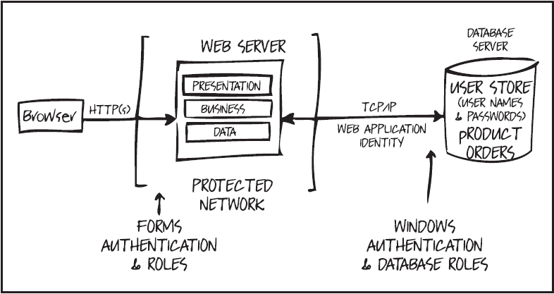
Whiteboard Your Architecture
It is important that you are able to whiteboard your architecture

Slide 15
Key Issues
Identify the issues in your application architecture to understand the areas where mistakes are most likely to be made
Quality Attributes
Crosscutting Concerns
Designing for Issue Mitigation

Slide 16
Quality Attributes
Quality attributes are the overall features of your architecture that affect run-time behavior, system design, and user experience
A combination of quality attributes such as usability, performance, reliability, and security indicates the success of the design and the overall quality of the software application
Quality attributes represent areas of concern that have the potential for application-wide impact across layers and tiers
Use the following list to help you organize the quality attributes, and to understand which scenarios they are most likely to affect:
System qualities
The overall qualities of the system when considered as a whole; such as supportability and testability
Run-time qualities
The qualities of the system directly expressed at run-time; such as availability, interoperability, manageability, performance, reliability, scalability, and security
Design qualities
The qualities reflecting the design of the system; such as conceptual integrity, flexibility, maintainability, and reusability
User qualities
The usability of the system

Slide 17
Crosscutting Concerns
Crosscutting concerns are the features of your design that may apply across all layers, components, and tiers
Examples of crosscutting concerns are:
Authentication and Authorization
How you choose appropriate authentication and authorization strategies, flow identity across layers and tiers, and store user identities
Caching
How you choose an appropriate caching technology, determine what data to cache, where to cache the data, and a suitable expiration policy
Communication
How you choose appropriate protocols for communication across layers and tiers, design loose coupling across layers, perform asynchronous communication, and pass sensitive data

Slide 18
Crosscutting Concerns
Examples of crosscutting concerns are:
Configuration Management
How you determine what information must be configurable, where and how to store configuration information, how to protect sensitive configuration information, and how to handle configuration information in a farm or cluster
Exception Management
How you handle and log exceptions, and provide notification when required
Logging and Instrumentation
How you determine which information to log, how to make the logging configurable, and determine what level of instrumentation is required
Validation
How you determine where and how to perform validation; the techniques you choose for validating on length, range, format, and type; how you constrain and reject input invalid values; how you sanitize potentially malicious or dangerous input; and how you can define and reuse validation logic across your application’s layers and tiers

Slide 19
Crosscutting Concerns
The crosscutting concerns for security are:
Auditing and Logging: Who did what and when?
Auditing refers to how your application records security-related events
Logging refers to how your application publishes information about its operation
Authentication: Who are you?
Authentication is the process where one entity definitively establishes the identity of another entity, typically with credentials such as a username and password
Authorization: What can you do?
Authorization refers to how your application controls access to resources and operations
Configuration Management
What context does your application run under? Which databases does it connect to? How is your application administered? How are these settings protected?
Configuration management refers to how your application handles these operations and issues

Slide 20
Crosscutting Concerns
The crosscutting concerns for security are:
Cryptography
How are you handling secrets (confidentiality)? How are you tamper-proofing your data or libraries (integrity)? How are seeding random values that must be cryptographically strong?
Cryptography refers to how your application enforces confidentiality and integrity
Exception Management
When a method call in your application fails, what does your application do? How much information does it reveal? Does it return friendly error messages to end users? Does it pass valuable exception information back to the calling code? Does it fail gracefully? Does it help administrators to perform root cause analysis of the fault?
Exception management refers to how you handle exceptions within your application

Slide 21
Crosscutting Concerns
The crosscutting concerns for security are:
Input and Data Validation
How do you know that the input your application receives is valid and safe? Does it constrain input through entry points and encode output through exit points. Can it trust data sources such as databases and file shares?
Input validation refers to how your application filters, scrubs, or rejects input before additional processing.
Sensitive data
How does your application handle sensitive data? Does it protect confidential user and application data?
Sensitive data refers to how your application handles any data that must be protected either in memory, over the network, or in persistent stores.
Session Management
How does your application handle and protect user sessions?
A session refers to a set of related interactions between a user and your application.

Slide 22
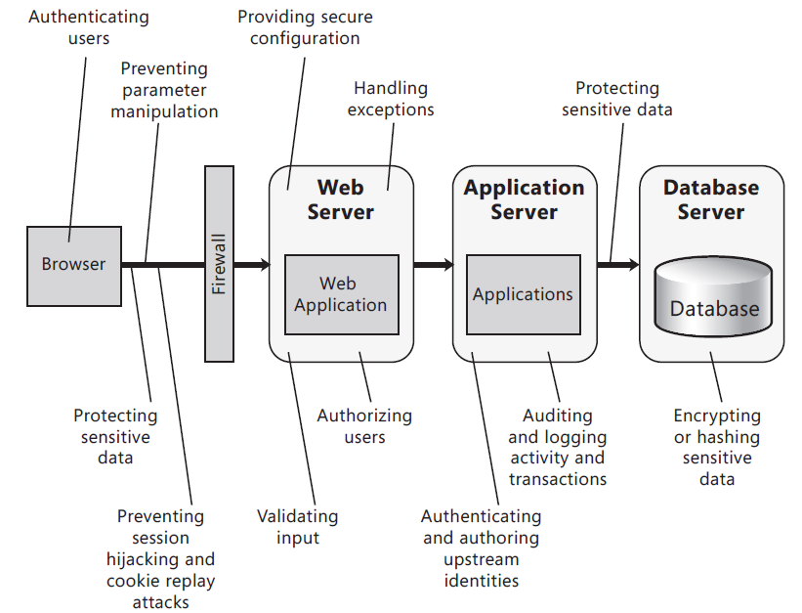
Security issues identified in a typical Web application architecture

